Slide 1

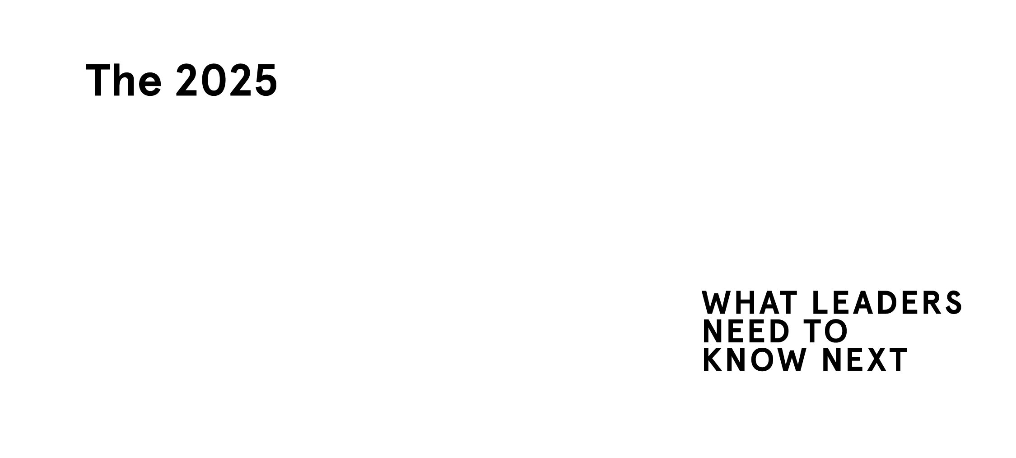
This slide deck includes animations.
Some slides will only show all content in presenter mode.
Referencing in academic publications​
Peter, S., Riemer, K., Norman, P. (2024). The 2025 Skills Horizon.​
Sydney Executive Plus, The University of Sydney, https://doi.org/10.25910/57M8-SQ33
​
Referencing on social media​
Please include the report URL: plus.sydney.edu.au/horizon

Slide 2
5 things to worry about
01
The values shift
Fractured values and fragmenting expectations
02
The technology shift
Strategic necessities with no clear direction
03
The accountability shift
Accountability across boundaries and the provenance economy
04
The trust shift
The erosion of trust in institutions,
ideas and geopolitical stabilities
05
The energy shift
An inelegant transition without
a coherent story
Source: The 2025 Skills Horizon (Peter et al 2024)

Slide 3
A
Assess and adapt
Understand your leaders’ skills against external changes and future needs.
What do your leaders need to know next?
B
Build a shared base
Think about leadership skills as shared, not individual, as broad, not exclusive.
Are your leaders on the same page?
Skills-based
leader development
C
Chart leaders' careers
Think ahead when crafting your leaders’ career pathways. Are you strategically developing leaders?
D
Develop and learn
Make learning and upskilling part of your organisation’s DNA. Are you continuously developing your leaders?
E
Evaluate and evolve
As your leaders advance, adjust your program accordingly. Are you keeping
your leader development future-proof?
Source: The 2025 Skills Horizon (Peter et al 2024)

Slide 4
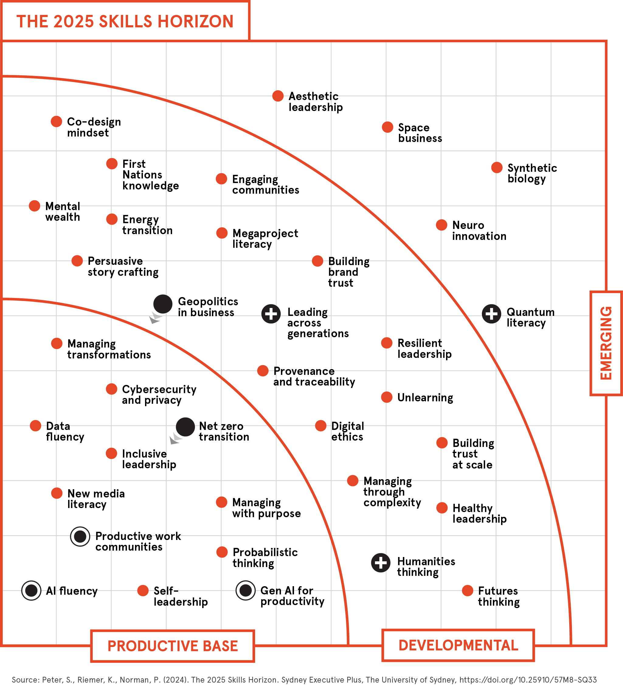
The 2025
Skills Horizon

Slide 5
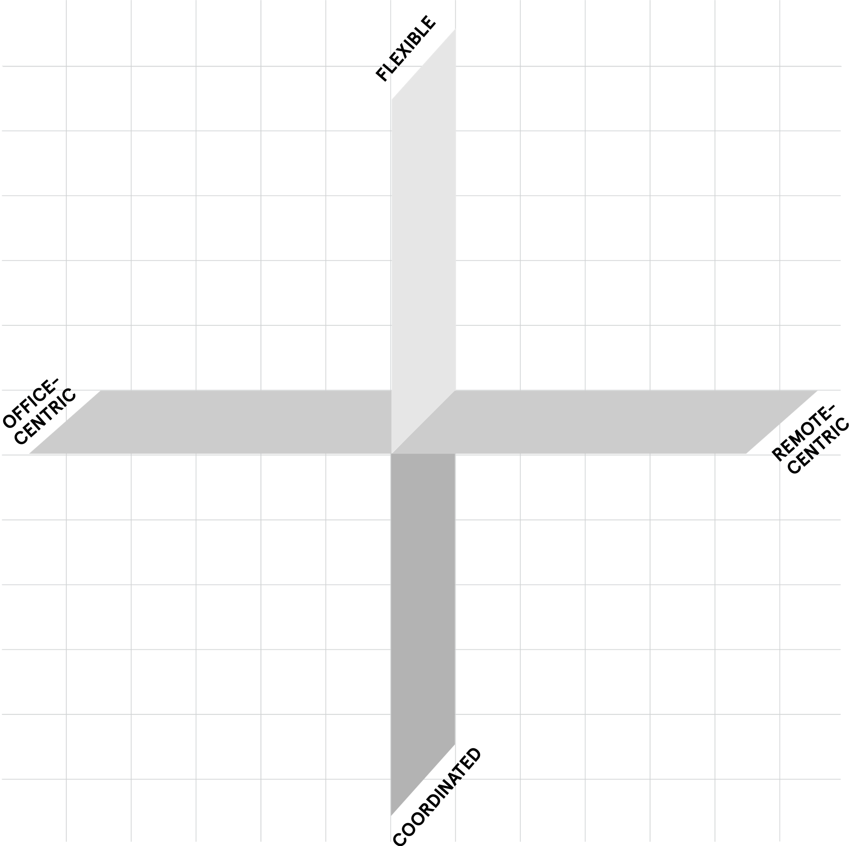
Types of hybrid work
This slide includes animations.
Some content will only show in presenter mode.
Flexible
hybrid
Online-
first
hybrid
Flexible hybrid
This is the “anything goes, each to their own” model. There are no fixed rules about where and when to work; the office runs like a campus, with teams coordinating their own rhythms.
Space-share hybrid
The office is the focal point, but people rotate
through the space doing desk-sharing. It’s either
a first come, first serve basis or more coordinated,
with allocated seats.
Online-first hybrid
Everyone works mostly remote. The physical space is used only for socialising or client
meetings. Coming together physically can be
coordinated or flexible.
Cohort hybrid
Here, the team is the focal point, rather than the space. Under this enforced hybrid model, teams
are always together: some days in the office, some days remote.
Traditional hybrid
Revolves around the traditional nuclear office.
Some people work (almost) permanently from
home (akin to the telework of old); most people
work in the office.
Space-
share
hybrid
Traditional
hybrid
Cohort
hybrid
Source: The 2025 Skills Horizon (Peter et al 2024)

Slide 6
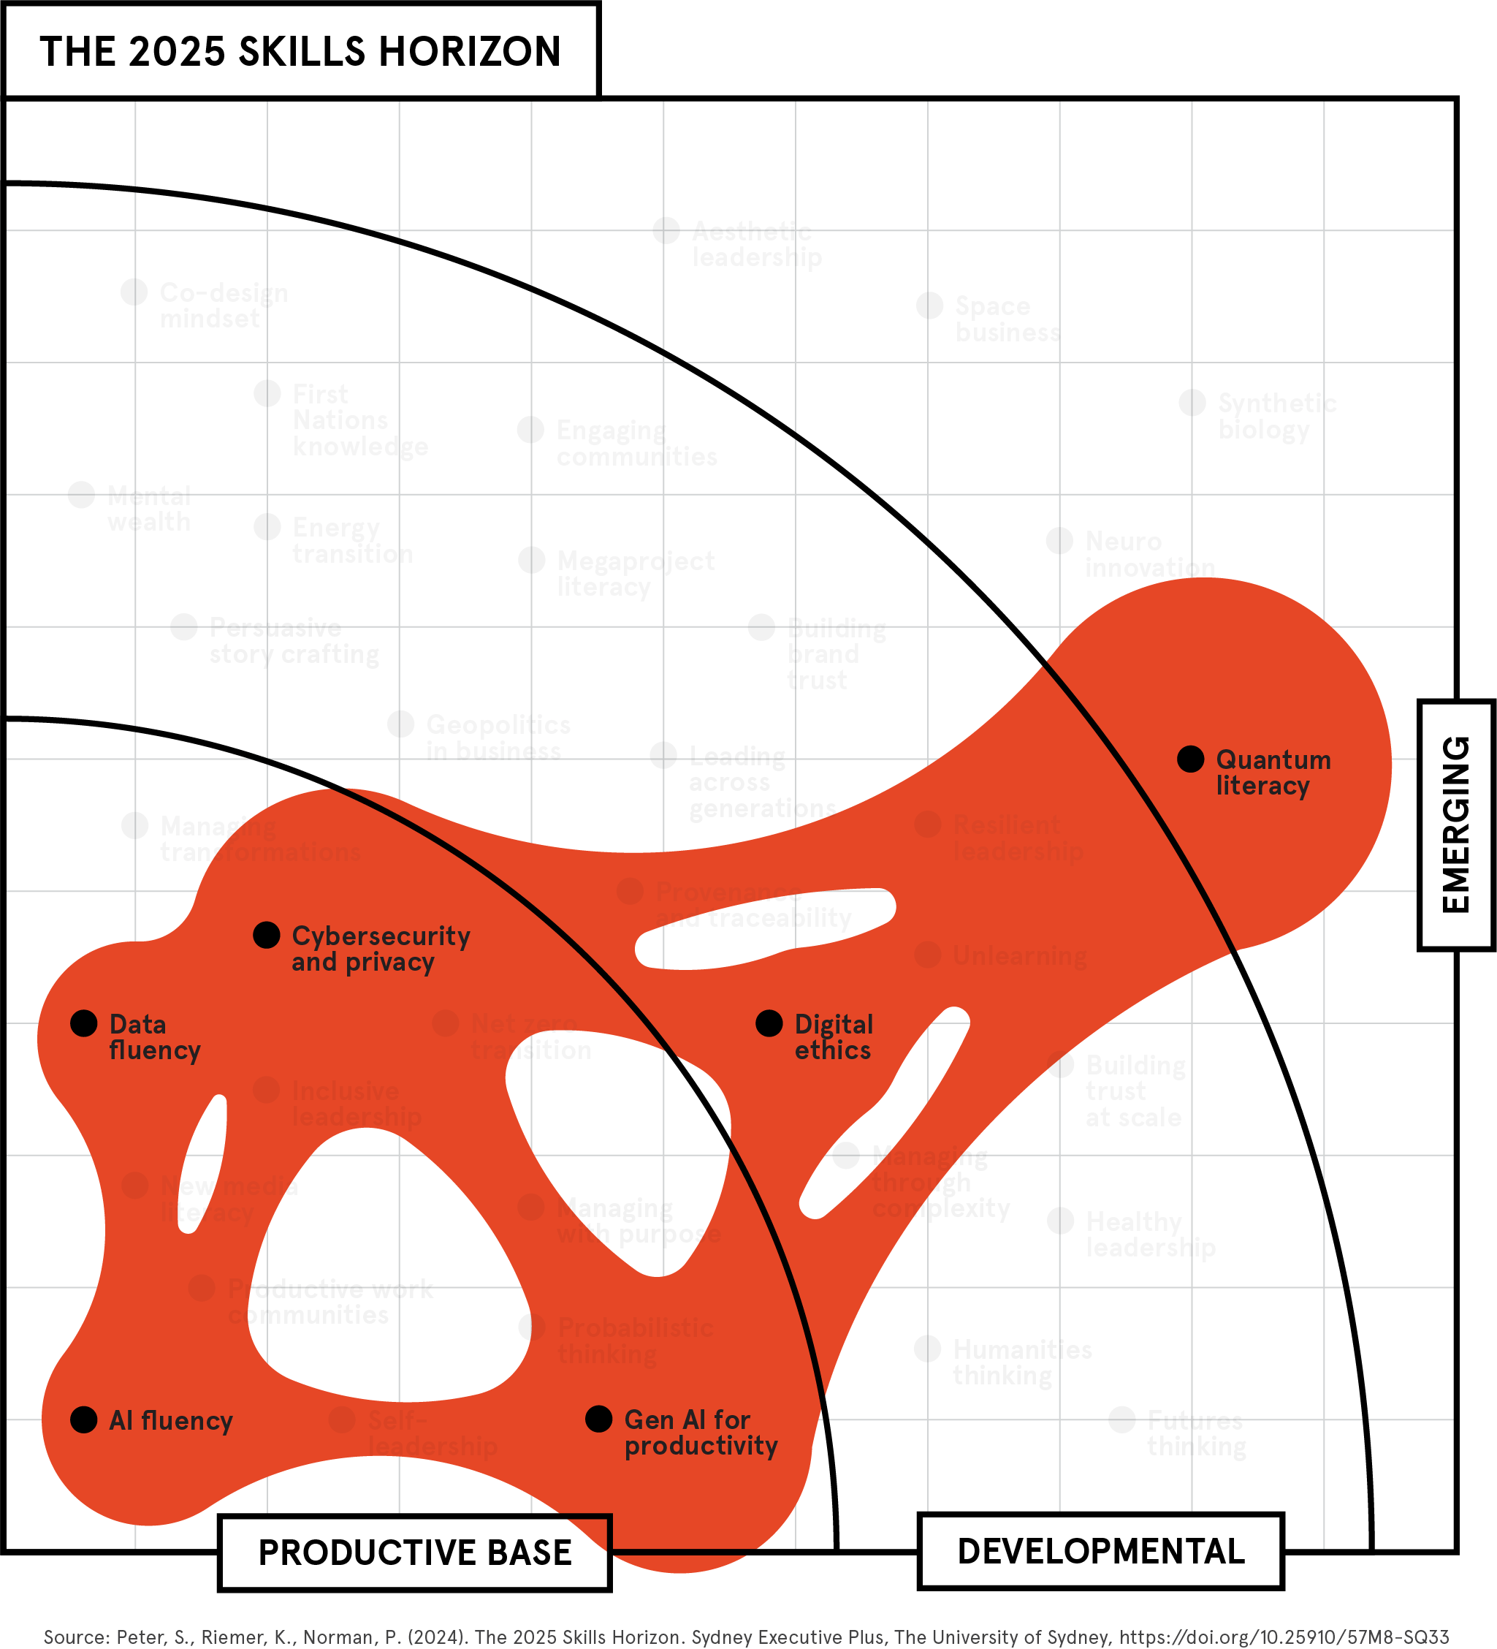
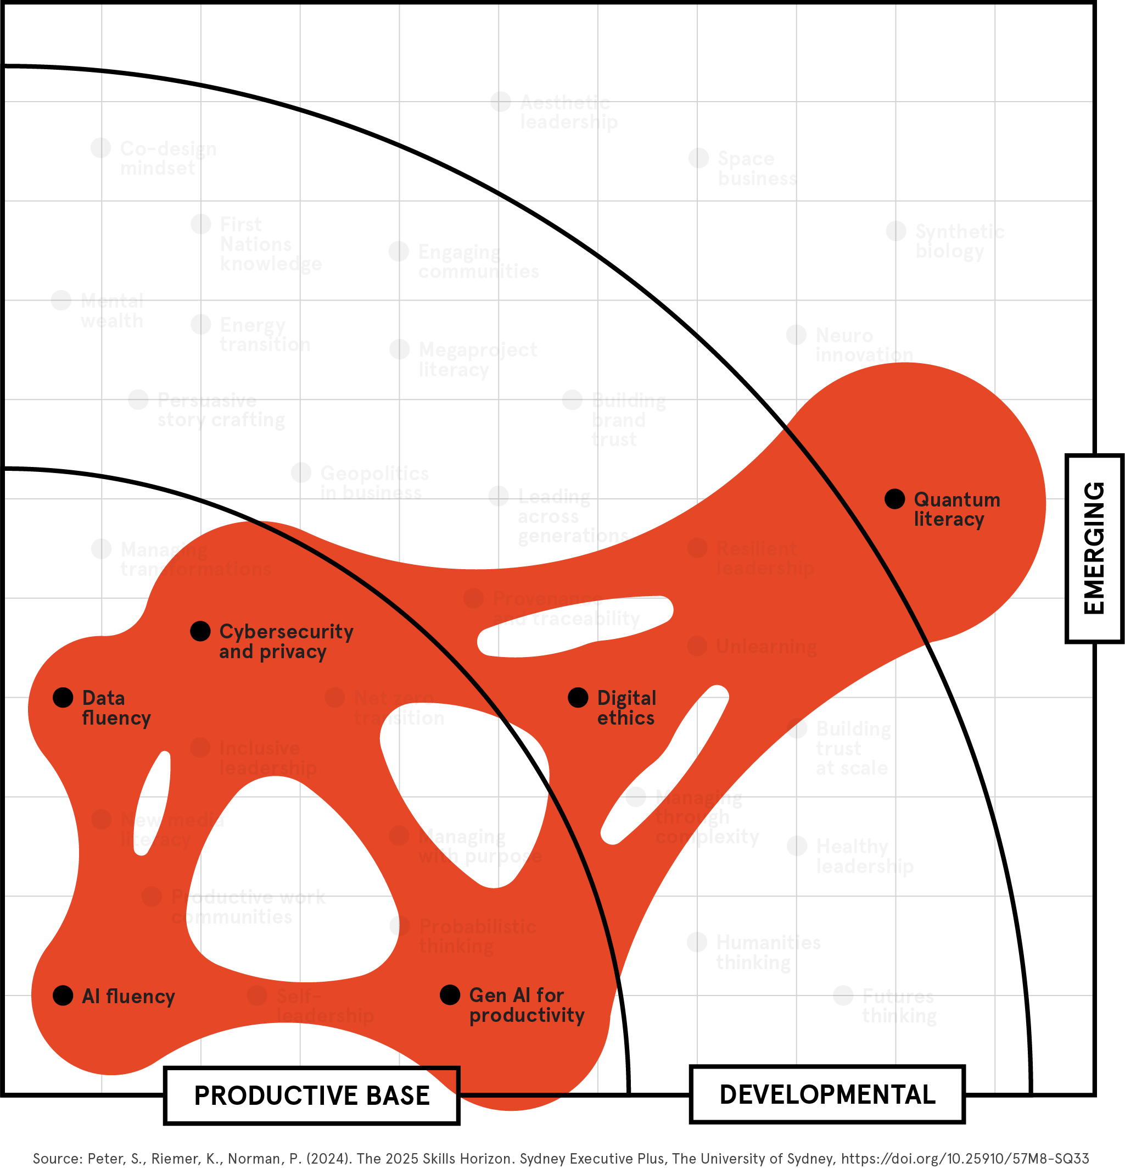

BLOB 1
Speaking the
language of tech
QUANTUM
LITERACY
CYBERSECURITY
AND PRIVACY
DIGITAL
ETHICS
DATA FLUENCY
GEN AI FOR
PRODUCTIVITY
AI FLUENCY

Slide 7
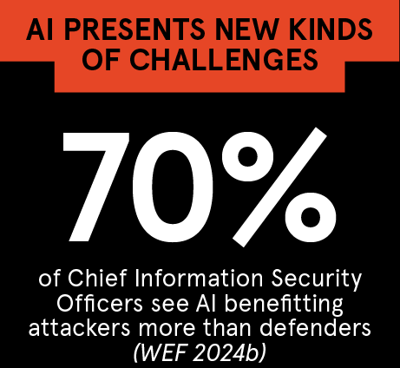
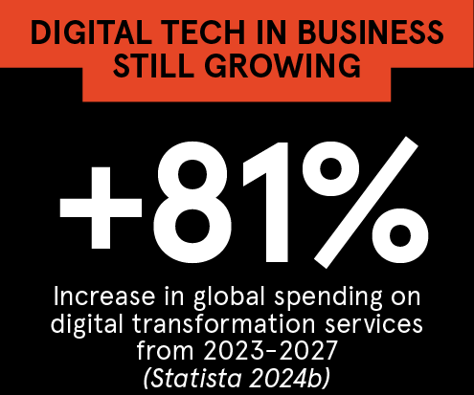
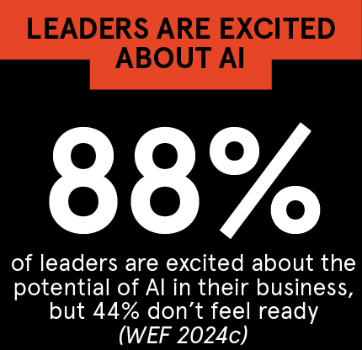
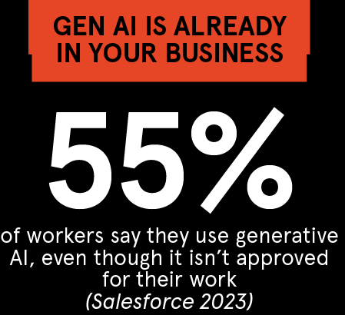

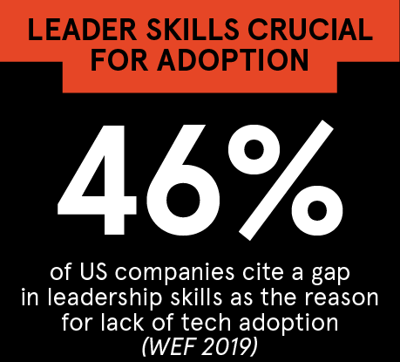
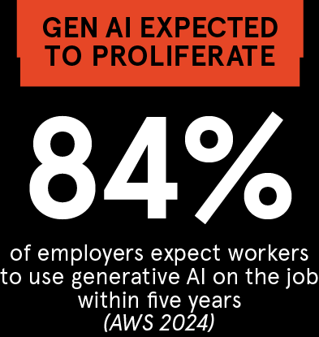
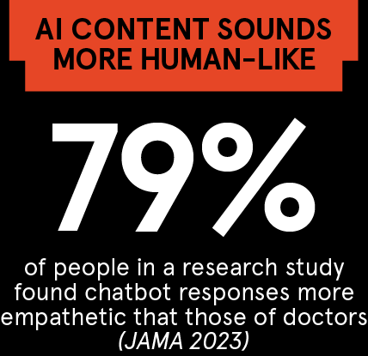

Speaking the language of tech,
in numbers
Source: The 2025 Skills Horizon (Peter et al 2024)
Notes:
Statista 2024b: Spending on digital transformation technologies and services worldwide from 2017 to 2027, Statista, 13 Mar 2024: https://www.statista.com/statistics/870924/worldwide-digital-transformation-market-size/
WEF 2019: Towards a Reskilling Revolution: Industry-Led Action for the Future of Work World Economic Forum, 22 Jan 2019: https://www.weforum.org/publications/towards-a-reskilling-revolution-industry-led-action-for-the-future-of-work/
WEF 2024c: AI is changing the shape of leadership – how can business leaders prepare?, World Economic Forum, 10 May 2024: https://www.weforum.org/agenda/2024/05/ai-is-changing-the-shape-of-leadership-how-can-business-leaders-prepare/
AWS 2024: AI skills could boost salaries and accelerate career growth for workers in Australia, Amazon Web Services, 20 Mar 2024: https://www.aboutamazon.com.au/news/aws/digital-ai-skills-report-australia-2024
Salesforce 2023: More than Half of Generative AI Adopters Use Unapproved Tools at Work, Salesforce, 15 Nov 2023: https://www.salesforce.com/news/stories/ai-at-work-research/
Jama 2023: Comparing Physician and Artificial Intelligence Chatbot Responses to Patient Questions Posted to a Public Social Media Forum, JAMA Internal Medicine, 28 Apr 2023: https://jamanetwork.com/journals/jamainternalmedicine/article-abstract/2804309
WEF 2024b: Cybersecurity is on the frontline of our AI future. Here's why, World Economic Forum, 15 Jan 2024: https://www.weforum.org/agenda/2024/01/cybersecurity-ai-frontline-artificial-intelligence/
Statista 2024a: Cybercrime Expected To Skyrocket in Coming Years, Statista, 22 Feb 2024: https://www.statista.com/chart/28878/expected-cost-of-cybercrime-until-2027/
USSC 2023: Quantum technology: What’s in it for Australia?, United States Studies Centre, 23 Oct 2023: https://www.ussc.edu.au/quantum-technology-what-is-in-it-for-Australia

Slide 8
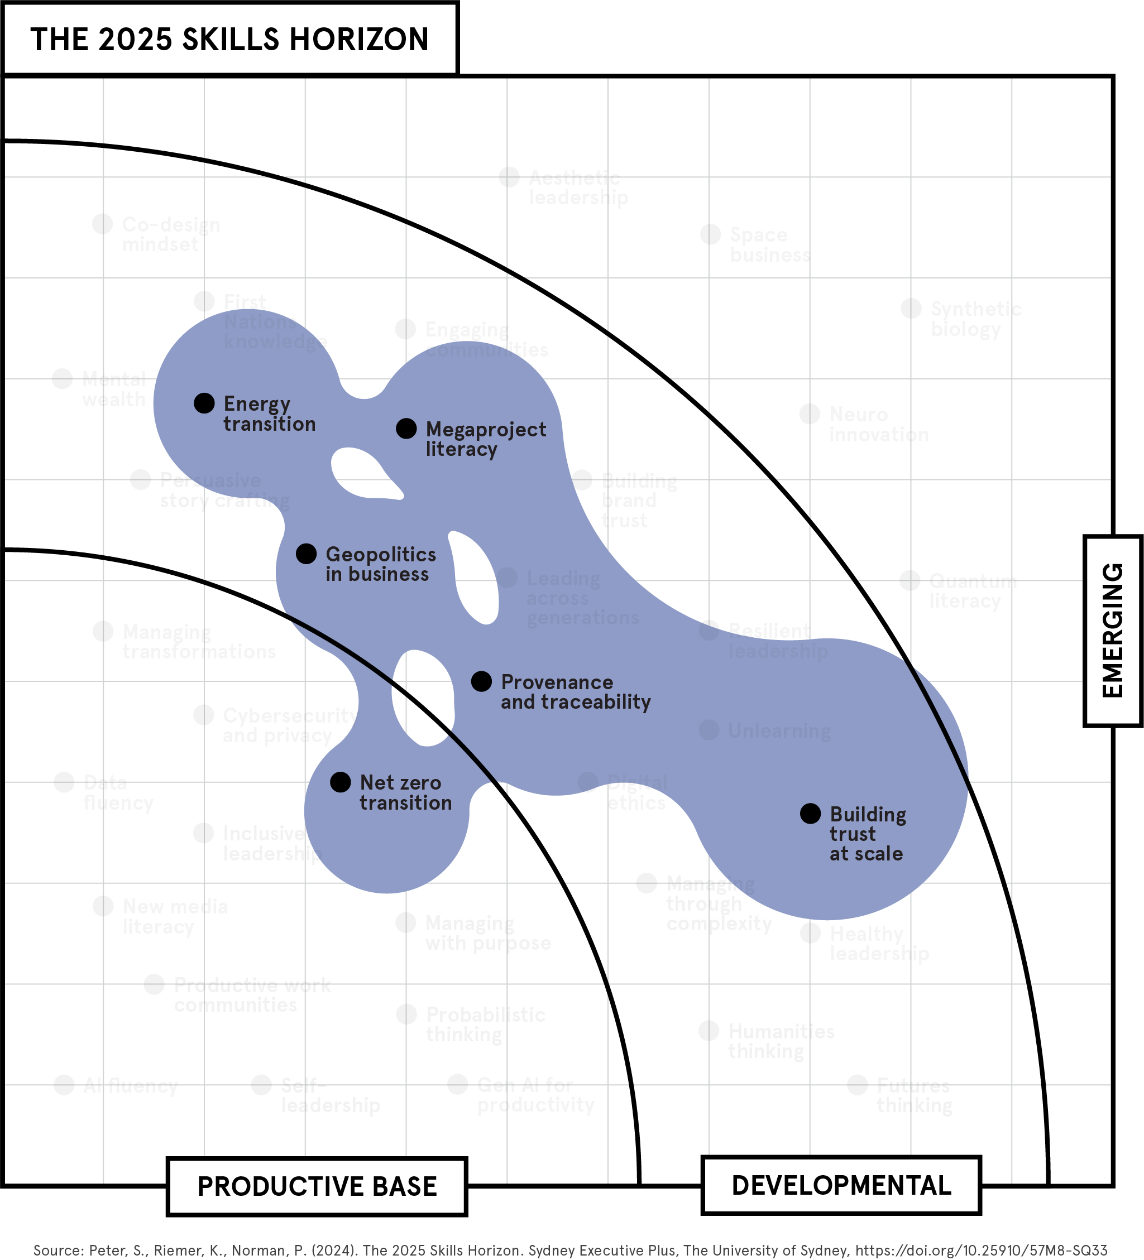

Solving problems of scale
BLOB 2
MEGAPROJECT
LITERACY
PROVENANCE
AND TRACEABILITY
ENERGY
TRANSITION
BUILDING TRUST
AT SCALE
GEOPOLITICS
IN BUSINESS
NET ZERO
TRANSITION

Slide 9

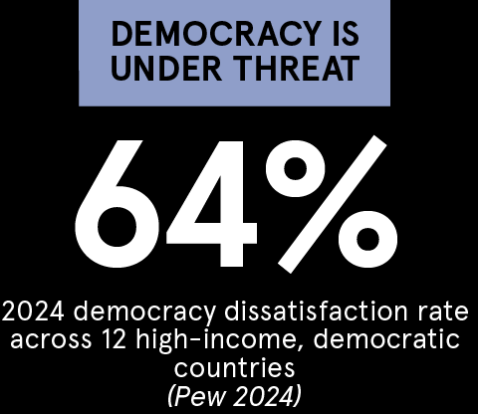
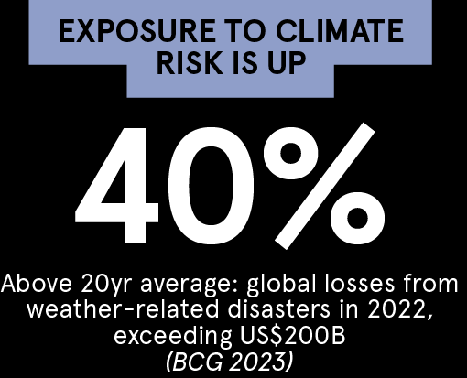

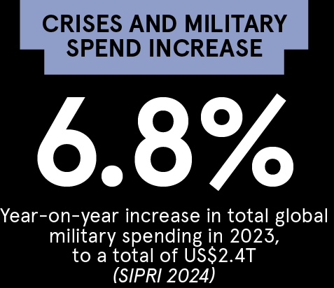
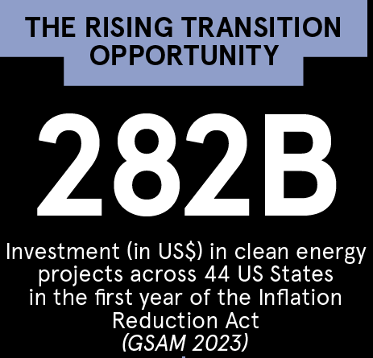
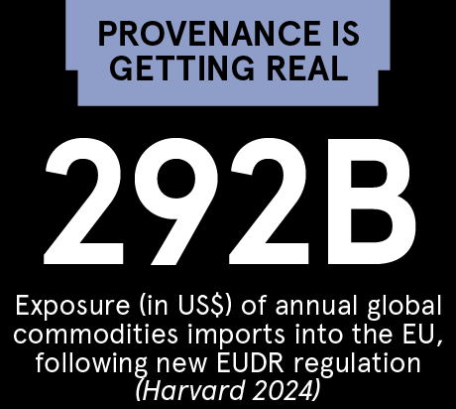
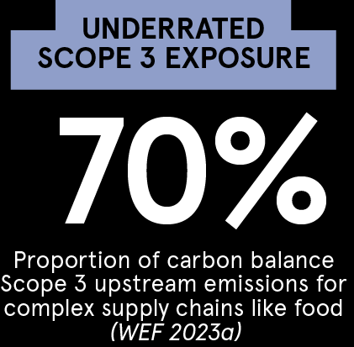
Solving problems of scale,
in numbers
Source: The 2025 Skills Horizon (Peter et al 2024)
Notes:
UN 2023: Key Statistics and Trends in International Trade 2023, United Nations Conference on Trade and Development, 2023: https://unctad.org/system/files/official-document/ditctab2024d1_en.pdf
SIPRI 2024: Trends in World Military Expenditure 2023, Stockholm International Peace Research Institute, Apr 2024: https://www.sipri.org/sites/default/files/2024-04/2404_fs_milex_2023.pdf
Pew 2024: Satisfaction with democracy has declined in recent years in high-income nations, Pew Research Center, 18 Jun 2024: https://www.pewresearch.org/short-reads/2024/06/18/satisfaction-with-democracy-has-declined-in-recent-years-in-high-income-nations/
BCG 2023: Coming to Grips with Corporate Climate Risk, Boston Consulting Group, 20 Nov 2023: https://www.bcg.com/publications/2023/coming-to-grips-with-corporate-climate-risk
GSAM 2023: The US Inflation Reduction Act is driving clean-energy investment one year in, Goldman Sachs Asset Management, 31 Oct 2023: https://www.gsam.com/content/gsam/us/en/institutions/market-insights/gsam-insights/perspectives/2023/us-inflation-reduction-act-is-driving-clean-energy-investment-one-year-in.html
Harvard 2024: The Atlas of Economic Complexity, Harvard Growth Lab, 2024: https://atlas.cid.harvard.edu/
ESGNews 2023: Global ESG Regulation Increases by 155% Over the Past Decade, ESG News, 20 Jun 2023: https://esgnews.com/global-esg-regulation-increases-by-155-over-the-past-decade/
WEF 2023a: Scope 3 emissions are key to decarbonization – but what are they and how do we tackle them?, World Economic Forum, 19 Sep 2023: https://www.weforum.org/agenda/2023/09/scope-3-emissions-are-key-to-decarbonization-but-what-are-they-and-how-do-we-tackle-them/

Slide 10
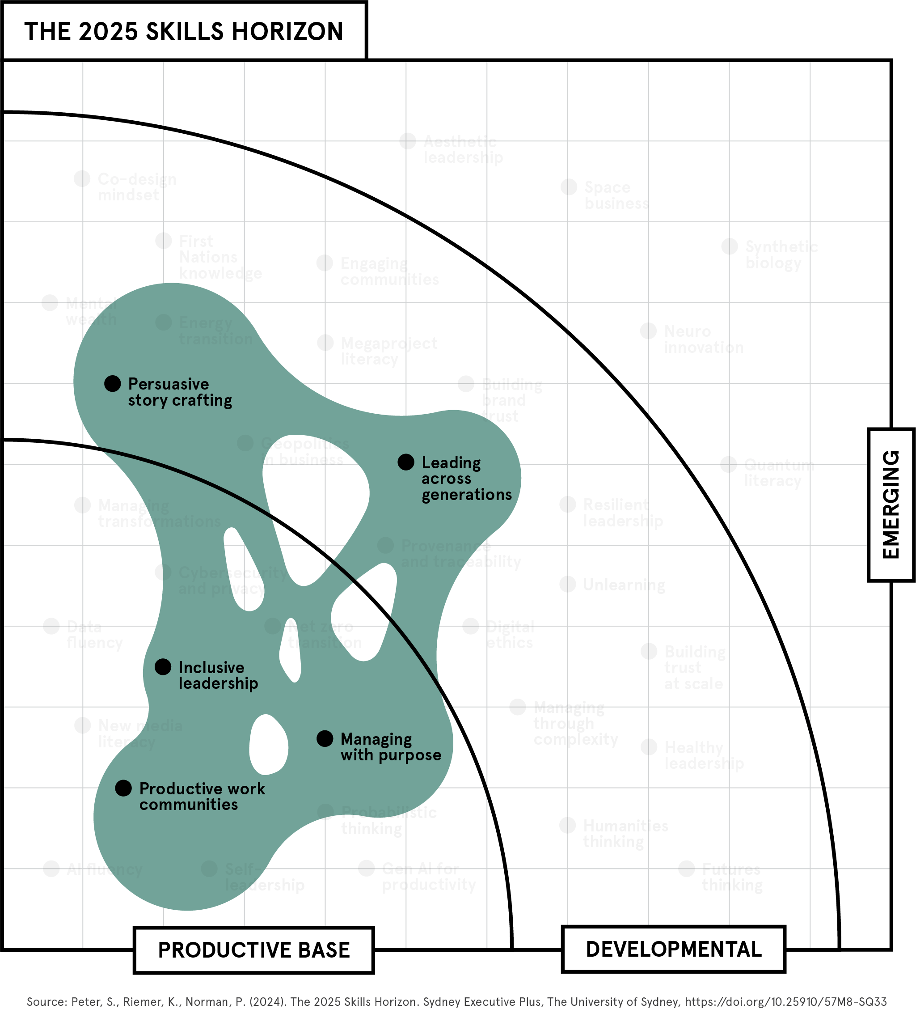

Working across difference
BLOB 3
PERSUASIVE
STORY CRAFTING
LEADING
ACROSS
GENERATIONS
INCLUSIVE
LEADERSHIP
MANAGING
WITH PURPOSE
PRODUCTIVE
WORK
COMMUNITIES

Slide 11
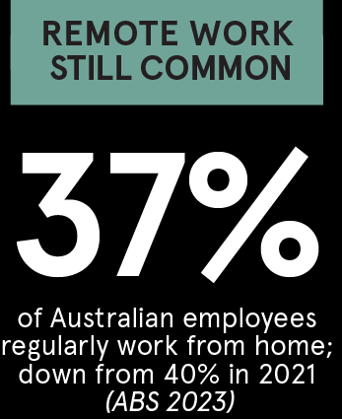


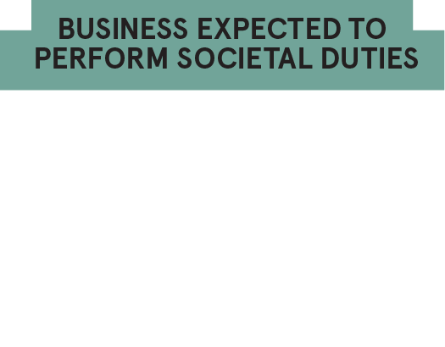
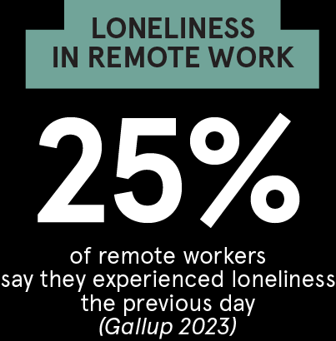

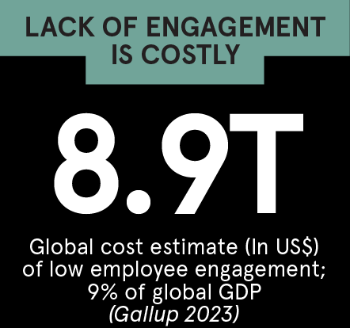
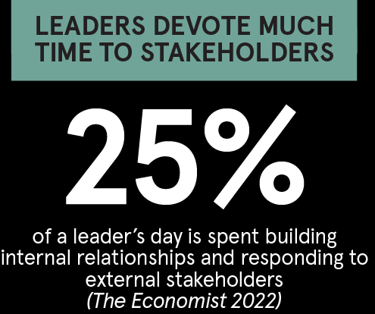
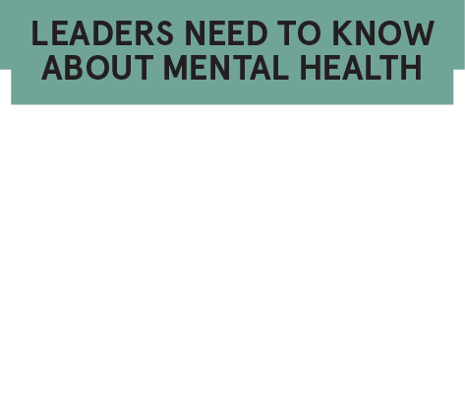
Working across difference,
in numbers
Source: The 2025 Skills Horizon (Peter et al 2024)
Notes:
Economist 2024: Why young men and women are drifting apart, The Economist, 13 Mar 2024: https://www.economist.com/international/2024/03/13/why-the-growing-gulf-between-young-men-and-women
WEF 2023b: Future of Jobs Report 2023, World Economic Forum, May 2023: https://www3.weforum.org/docs/WEF_Future_of_Jobs_2023.pdf
Salesforce 2017: Special Report: The Impact of Equality and Values Driven Business, Salesforce Research, 2017: https://www.salesforce.com/content/dam/web/en_us/www/assets/pdf/datasheets/salesforce-research-2017-workplace-equality-and-values-report.pdf
Gallup 2023: State of the Global Workplace, Gallup: https://www.gallup.com/workplace/349484/state-of-the-global-workplace.aspx
HBR 2024: How Companies Should Weigh In on a Controversy, Harvard Business Review, Mar-Apr 2024: https://hbr.org/2024/03/how-companies-should-weigh-in-on-a-controversy
Economist 2022: How modern executives are different from their forebears, The Economist, 16 Jun 2022: https://www.economist.com/business/2022/06/16/how-modern-executives-are-different-from-their-forebears
ABS 2023: Working arrangements, Australian Bureau of Statistics, 13 Dec 2023: https://www.abs.gov.au/statistics/labour/earnings-and-working-conditions/working-arrangements/latest-release
Gallup 2023: State of the Global Workplace, Gallup: https://www.gallup.com/workplace/349484/state-of-the-global-workplace.aspx
MHA 2022: Mind the Workplace 2022 Report: Employer Responsibility to Employer Mental Health, Mental Health America, Feb 2022: https://mhanational.org/sites/default/files/MTW_Report_2022.pdf

Slide 12
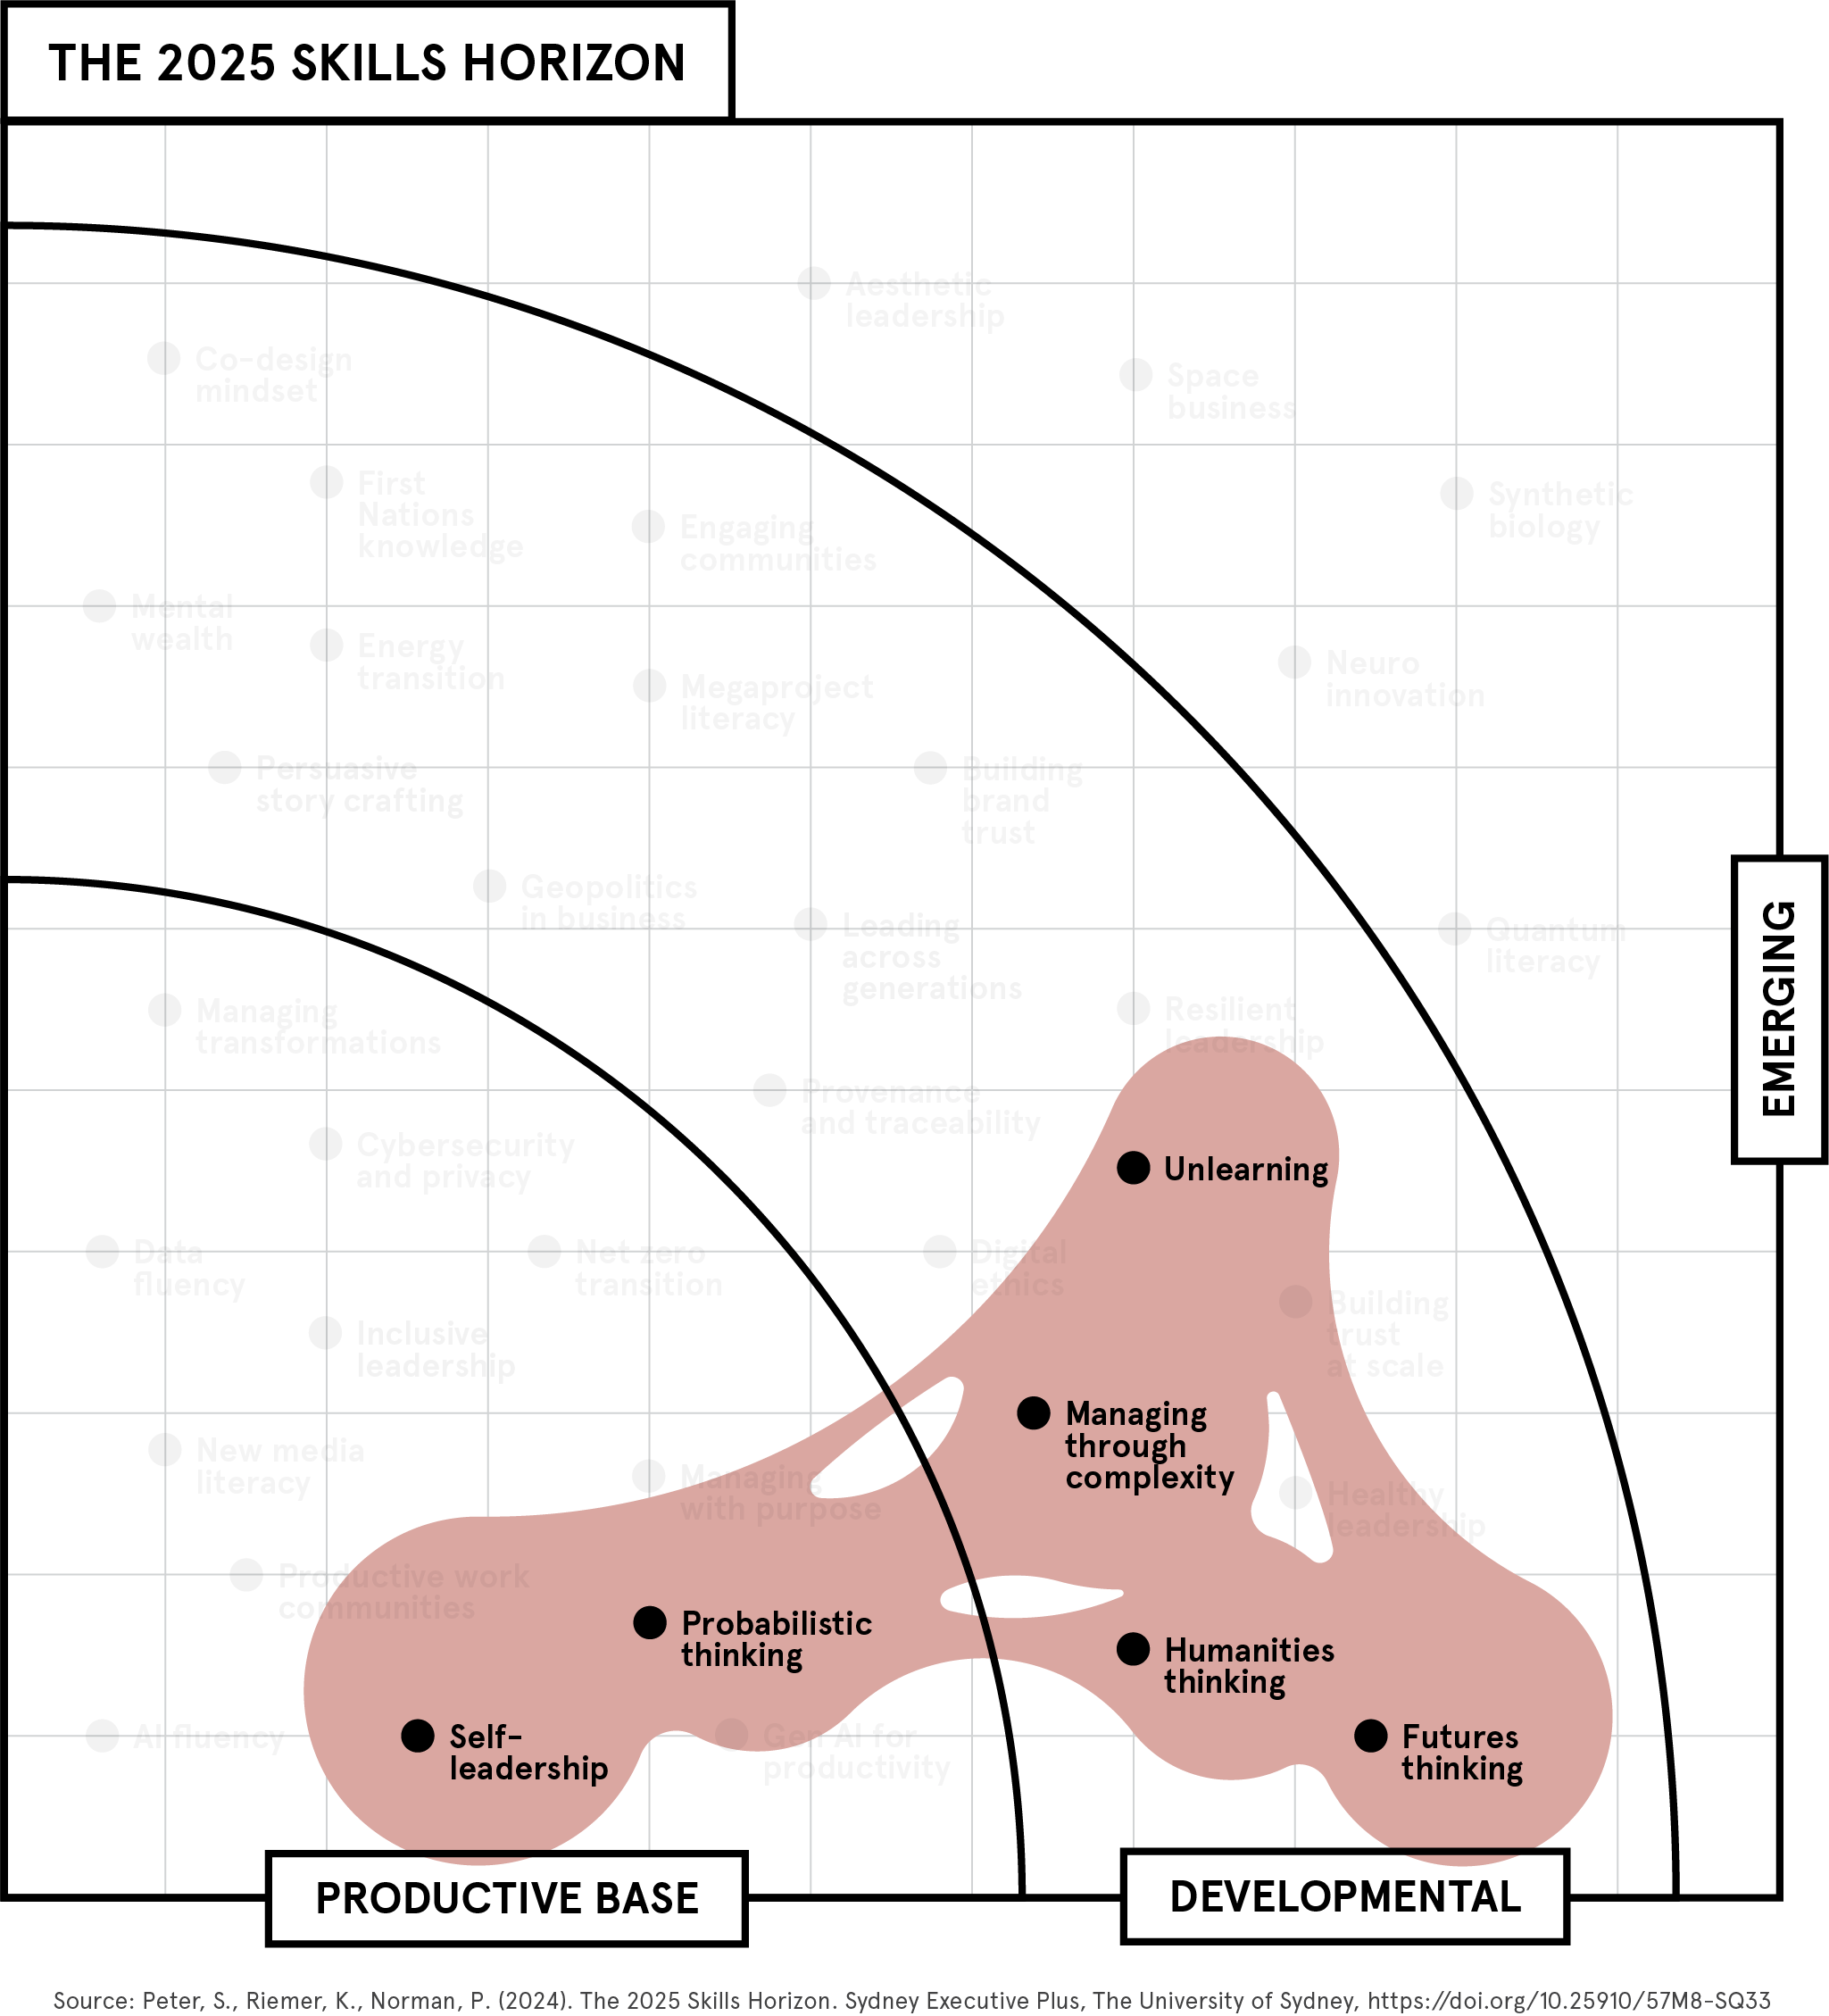

Thinking through complexity
BLOB 4
UNLEARNING
PROBABILISTIC
THINKING
SELF-
LEADERSHIP
MANAGING
THROUGH
COMPLEXITY
HUMANITIES
THINKING
FUTURES
THINKING

Slide 13
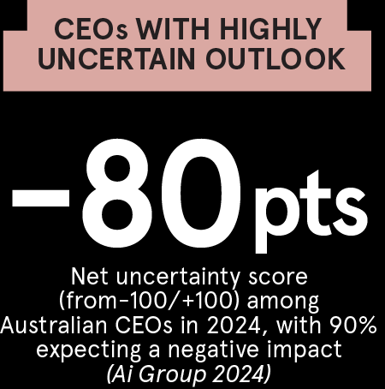
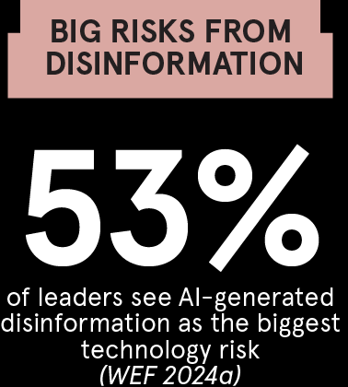
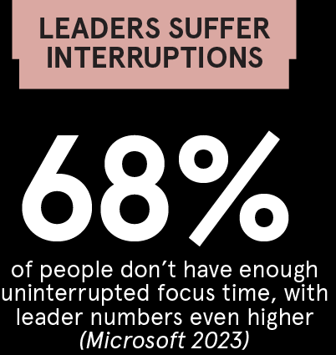
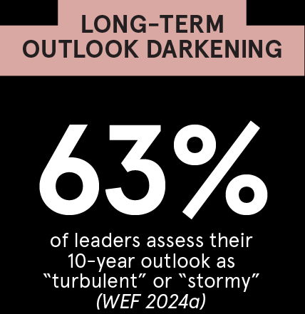
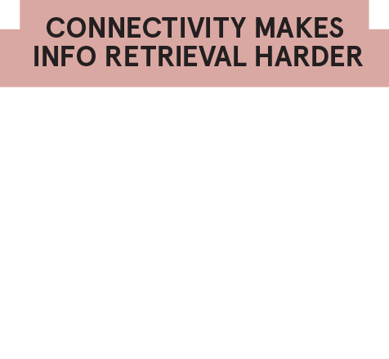
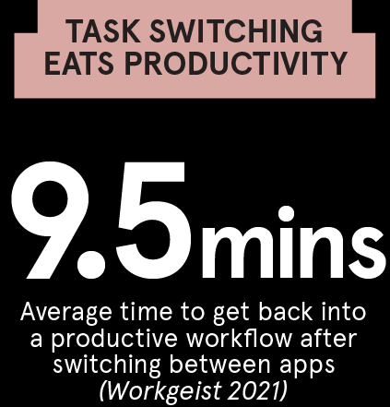
Thinking through complexity,
in numbers
Source: The 2025 Skills Horizon (Peter et al 2024)
Notes:
Ai Group 2024: CEO Expectations Survey, Australian Industry Outlook for 2024, Australian Industry Group, Jan 2024: https://www.aigroup.com.au/globalassets/news/reports/2024/research-and-economics/ai-group-australian-industry-outlook-for-2024.pdf
WEF 2024a: The Global Risks Report 2024, World Economic Forum, Jan 2024: https://www3.weforum.org/docs/WEF_The_Global_Risks_Report_2024.pdf
WEF 2024a: The Global Risks Report 2024, World Economic Forum, Jan 2024: https://www3.weforum.org/docs/WEF_The_Global_Risks_Report_2024.pdf
Workgeist 2021: Workgeist Report, Qatalog & Cornell University, 2021: https://language.work/research/workgeist/
Microsoft 2023: Work Trend Index: Annual Report, Microsoft, 9 May 2023: https://assets-c4akfrf5b4d3f4b7.z01.azurefd.net/assets/2023/09/e3227681-b882-4050-b201-a631431ad2a5-WTI_Will_AI_Fix_Work_060723.pdf
Workgeist 2021: Workgeist Report, Qatalog & Cornell University, 2021: https://language.work/research/workgeist/

Slide 14




Upskill with us:
AI fluency sprint
You’ve got the slides.
Now get the skills.
Brand leadership sprint
Net zero sprint
Geopolitics and business sprint
Learn more and enrol: plus.sydney.edu.au/our-sprints/
Get in touch with us:
executive.plus@sydney.edu.au

